Slide 1
COVID-19 Beverage Update
August 2020

Slide 2
Overview
Due to impacts of COVID-19 across the Foodservice industry, and the impact of State and Local Restrictions on Self-Serve operations, we have pulled together the following summary to assist your decision making during this difficult and dynamic time.
Our goal is to support your operations by:
Update recommended cleaning instructions for all dispensers
Preview solutions in the development pipeline that will enable touch-free dispensing
Provide options for those machines that can not be self-serve at this time
If you have any questions regarding your machines, or the solutions mentioned in this presentation, please reach out to your local Nestle repetitive or your Sodexo/Entegra National Account Representative, Mike Burris (Michael.burris@us.nestle.com)
Stay Safe!

Slide 3
Table of Contents:
Machine Care & Cleaning
Touchless Technology Preview
Served Solutions Ideas
  Hand Mix Juices
  Coffee Service Support
  Single Serve Packets
    Nescafe Stick Packs
    Nestle Hot Cocoa (Seasonal Program)

Slide 4
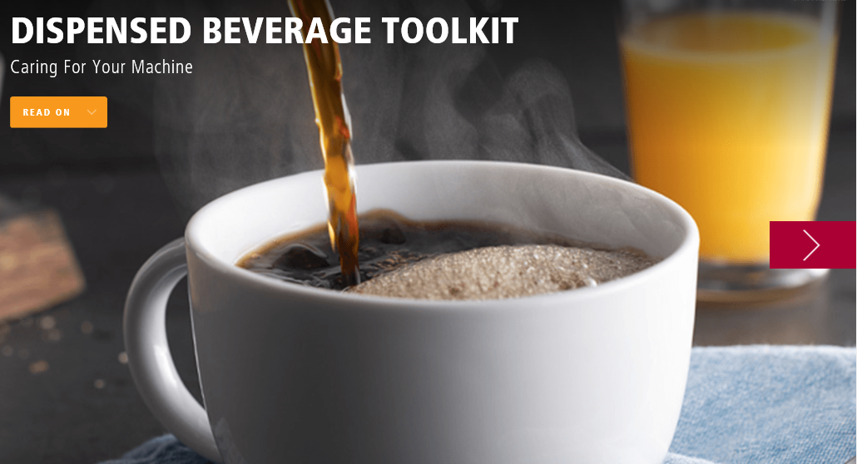
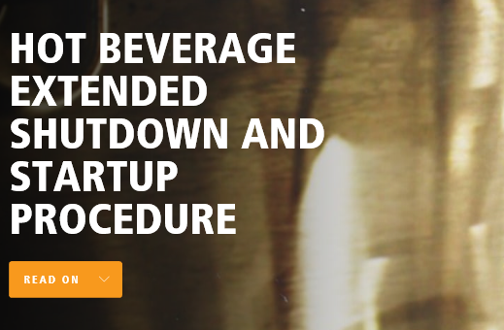
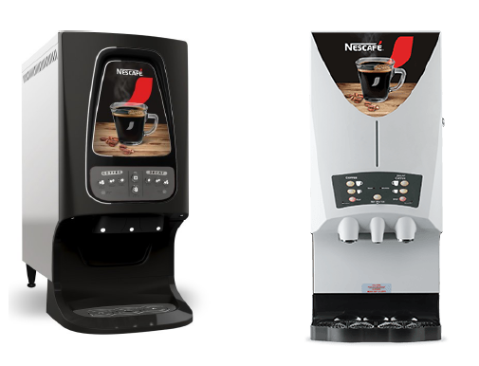
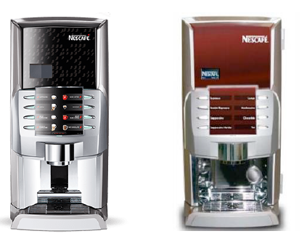
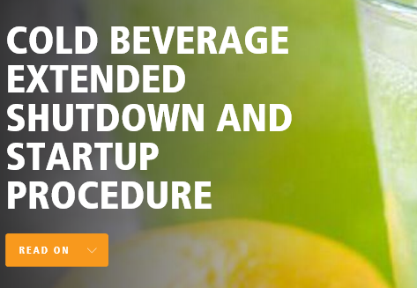
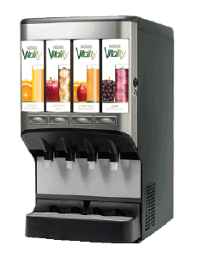
1. Cleaning & Caring for your Machines
Click Here
Click Here
Click Here
Includes:
Start Up, Shut Down Instructions
Cleaning/Flushing Procedures
[must be in presentation mode for links to work]
MASTER URL: https://nestleprofessional.turtl.co/story/dispensed-beverage-toolkit/page/1

Slide 5

2. Touchless Technology Preview
Machine: Krea Bean to Cup
Capability: QR enabled, Phone Ordering
Status: In Test
Commercial Timing: Q4, 2020
Machine: Express Juice Dispenser
Capability: Motion Activated Dispensing Buttons (touch-free)
Status: In Technical Development
Commercial Timing: Late Q4, 2020 for new installs, 2021 for retrofits

Slide 6
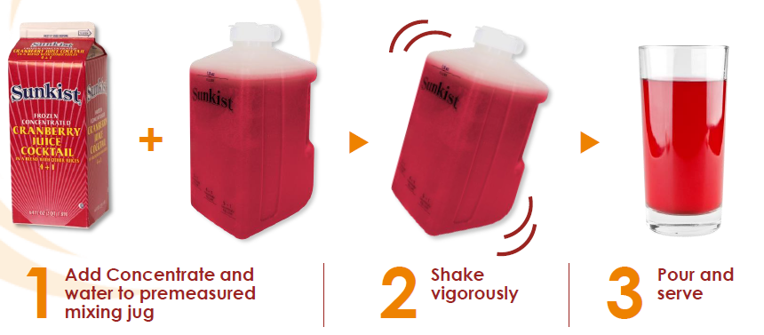
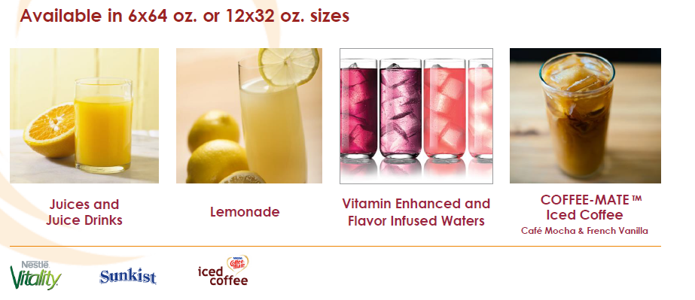
SERVED SOLUTION IDEAS
3a. Hand Mix Juices
Served Option to Temporarily Replace Dispensed Options
Lower Cost/Oz
No NFCS, No Artificial Flavors/Colors
Frozen or Ambient
FREE Mixing Jugs Available
Double-click for more information!

Slide 7
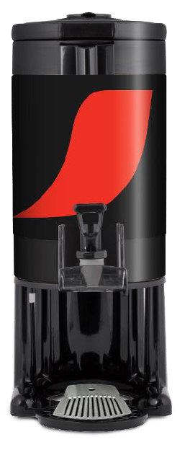
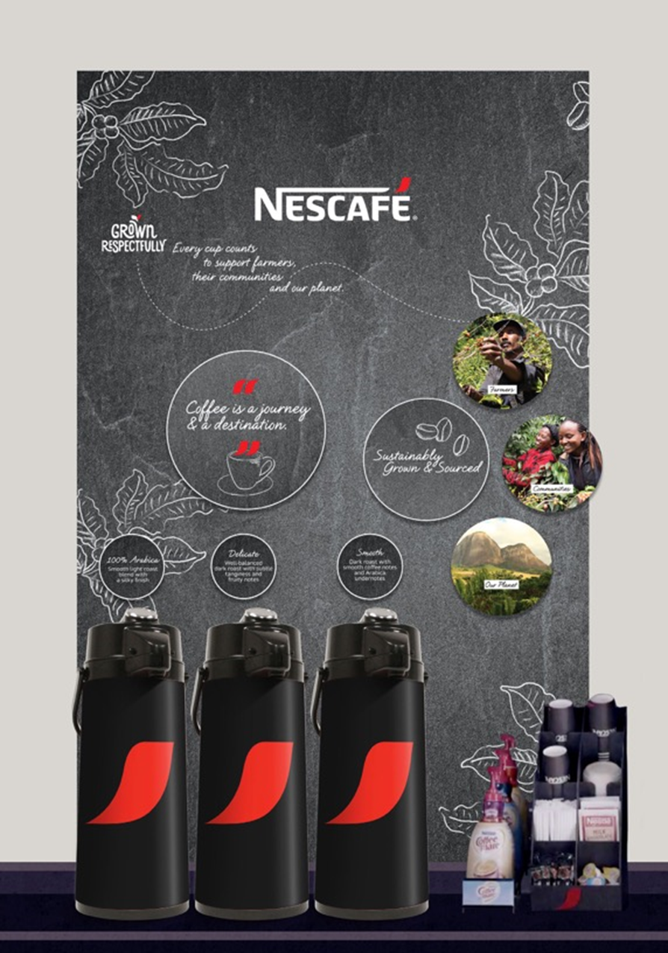
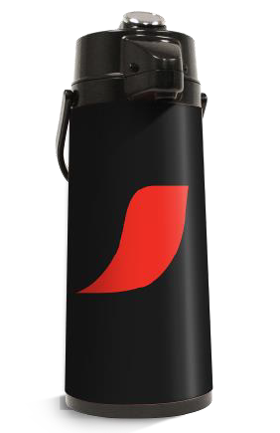

SERVED SOLUTION IDEAS
3b. Free Coffee Service Support
Sustainability Back Drop Boards
OR
Branded Cups
1 Gallon Urn
4-6 hr temp retention
2.2L Air pots
4-6 hr temp retention

Slide 8
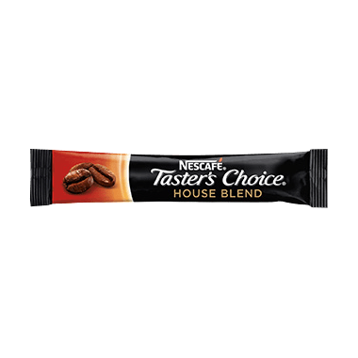
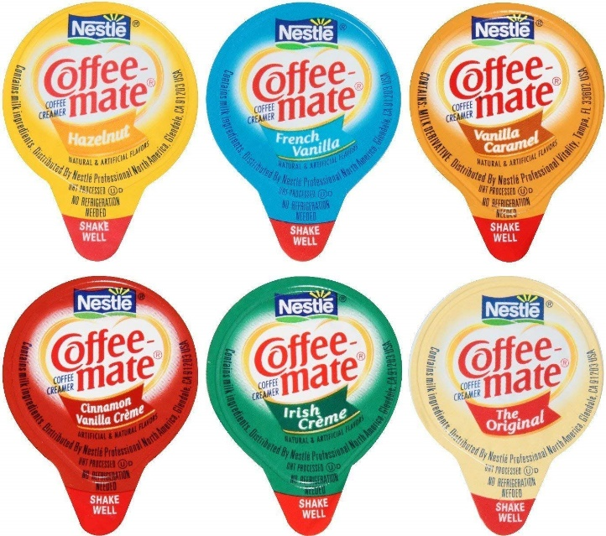
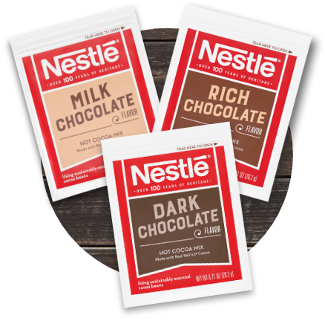
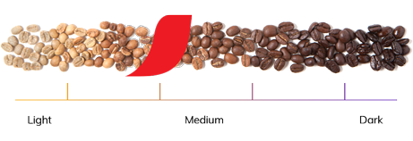
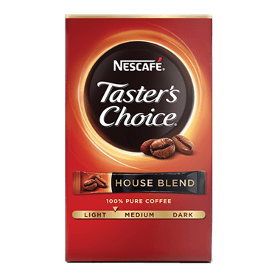
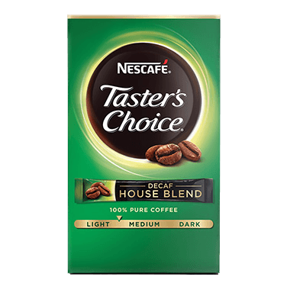
SERVED SOLUTION IDEAS
3c. Single Serve Options – Self Serve, Single Touch
Coffee
Portion Control Creamers
Cocoa
Seasonal PROMO!
$5 off up to $1500

Slide 9
For Questions / Interest Contact:
Michael.Burris@Us.Nestle.com

